Slide 1

VOICE BOTDEVELOPMENT AND IMPLEMENTATION
Greeshma Haridas
Meta Scifor technologies

Slide 2
Introduction
Objective: To create a general-purpose voice bot capable of handling diverse queries.
Scope:
Real-time interaction using voice and text.
Multi-functional capabilities: Wikipedia searches, jokes, date/time, and opening websites.
Easy-to-use interface with voice and text input.

Slide 3
What is a Voice Bots?
A voice bot is a smart assistant that interacts with people using spoken language, like having a conversation. It combines these technologies to work:
Speech Recognition (STT): Turns your spoken words into text.
Language Understanding (NLP): Figures out what you mean.
Speech Generation (TTS): Responds by speaking back to you.

Slide 4
Why Voice Bots?
Increasing demand for hands-free digital assistants.
Enhancing accessibility and user experience.
Bridging the gap between human language and machine responses.

Slide 5
Features
Voice & Text Input: Flexible interaction options.
Wikipedia Integration: Simplified search for essential topics.
Entertainment: Light-hearted jokes for user engagement.
Time & Date Queries: Immediate responses.
Web Navigation: Direct access to Google, YouTube.

Slide 6
Workflow
Input:
Voice recorded via microphone or typed text.
Processing:
Speech-to-text conversion.
Query analysis using NLP.
Response Generation:
Query handling using Wikipedia API, datetime, etc.
Text-to-speech conversion for output.
Output:
Audio and text-based responses.

Slide 7
Technologies Used
Programming Language: Python
Libraries/Tools
Streamlit (UI)
SpeechRecognition (Speech-to-Text)
gTTS (Google Text-to-Speech)
Wikipedia - For fetching information from Wikipedia.
NLTK (Natural Language Processing)
Pyjokes - For generating jokes.
Datetime - For handling date and time queries

Slide 8
Challenges
Balancing simplicity and functionality.
Handling ambiguous or broad queries.
Accurate transcription of speech input.
Managing errors in Wikipedia searches.

Slide 9
Demo & Visuals
This demo section includes links to the project and its resources, a video showcasing the system in action, and a detailed flowchart that explains how the voice bot functions..
GitHub Repository: link_to_project_repo
Deployed Project: link_to_app

Slide 10
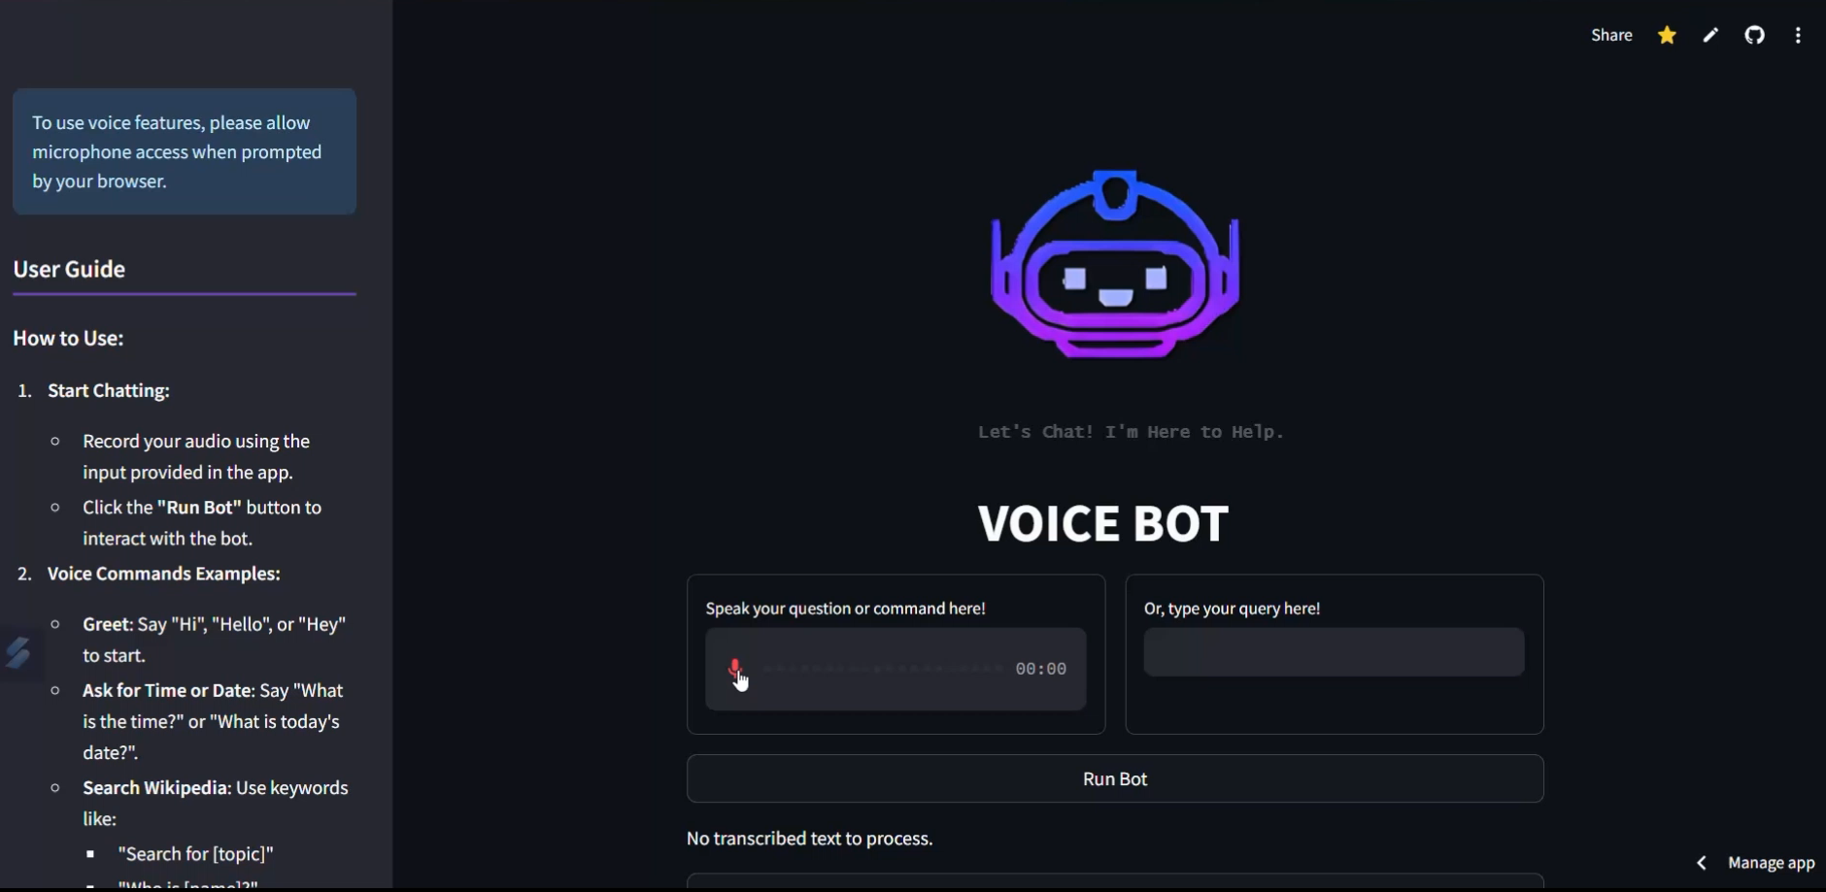
Video
A short demonstration showing the system in action.

Slide 11
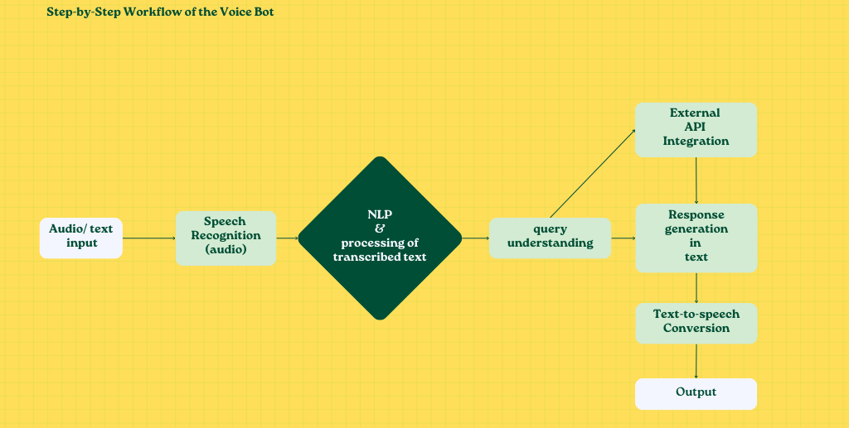
Flow Chart
Outline the key steps of your project or system.

Slide 12
Conclusion
Voice bot demonstrates the potential of conversational AI in simplifying tasks.
A valuable learning experience in NLP, APIs, and user interface design.
Opens up opportunities for further innovations in voice technology.

Slide 13
Acknowledgments
Special Thanks
Meta Scifor Technologies for project support.
Urooj Ma’am and team members for guidance.

